Slide 1
Databases & Programming Languages
Key Concepts:
  Middleware is used to connect applications to databases.
  Differerent types of middleware exist; we will use ODBC & JDBC.
    Connect to DBMS using driver provided by DBMS vendor.
    Formulate queries as strings.
    Query is forwarded to DBMS and result returned to application.
  Don’t make the application do things the database can do more easily.
    However some issues are more easily handled at the application-level than at the database level.
  The user of software relying on a database should NOT need to be aware of the tables in the database.

Slide 2
Database Connectivity
We often need application programs to connect and communicate with databases (or other data sources).
We want to be able to switch DBMS without having to re-write the code that interacts with the database.
There are many technologies that can be used to access a database from a programming language. These include:
ODBC (Open Database Connectivity)
JDBC (Java Database Connectivity)
DAO (Data Access Objects)
RDO (Remote Data Objects)
OLE-DB (Object Linking & Embedding)
ADO.NET (Active Data Objects)

Slide 3
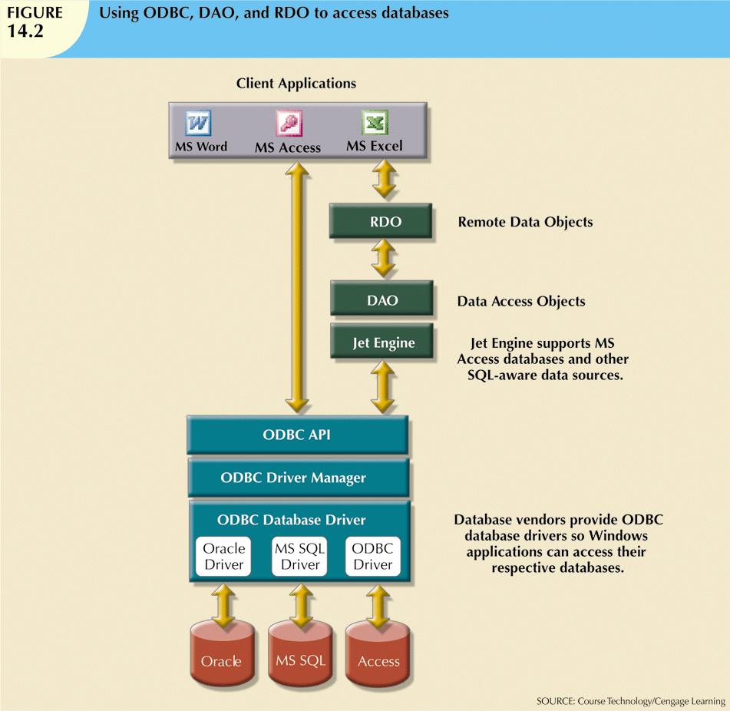
Python Program,
Java Program
Front-end
Middleware
Back-end
Database Systems, 10th Edition

Slide 4
ODBC
Open Database Connectivity (ODBC) is a set of programs that allows for standard ways for applications to connect to and interact with database systems.
It provides a middleware layer between the application and the database system.
  The application programmer needs to know how to use the ODBC API (Application Programming Interface).
  Each vendor provides drivers so ODBC can connect to their database.
  ODBC’s driver manager is in charge of managing all database connections and forwards the queries to the specific database system.
ODBC was originally developed by Microsoft. It is now widely available for most operating systems and database vendors.

Slide 5
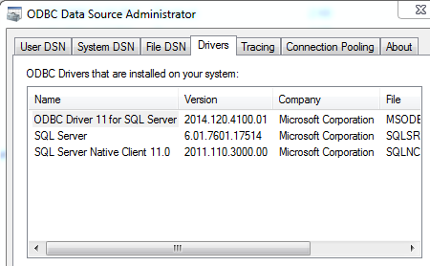
Drivers
You can find out what ODBC drivers you have on your Windows PC by navigating to Control Panel -> Administrative Tools -> Data Sources (ODBC).
In the pop-up window, click on the Drivers tab.

Slide 6
JDBC
Java Database Connectivity (JDBC) is a set of programs that allows for Java programs to connect to and interact with database systems.
It provides a middleware layer between the application and the database system.
  The application programmer needs to know how to use the JDBC API.
  Each vendor provides drivers so JDBC can access their database.
  JDBC’s driver manager is in charge of managing all database connections and forwards the queries to the specific database system.
JDBC was developed by Sun, now owned by Oracle. It can make use of ODBC, through a JDBC-ODBC “bridge”, which converts JDBC statements into the corresponding ODBC statements.

Slide 7
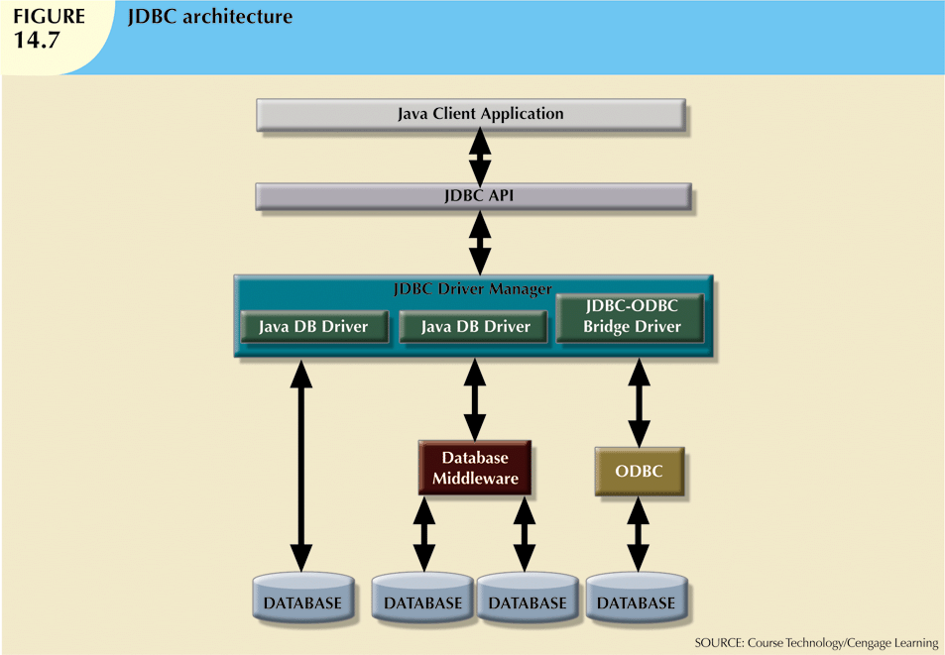
Database Systems, 10th Edition

Slide 8
Other Database Interfaces
There are many other technologies that can be used to access a database from a programming language.
  E.g. DAO (Data Access Objects), RDO (Remote Data Objects), OLE-DB (Object Linking & Embedding), ADO.NET (Active Data Objects), ….
They vary in many ways:
Applicability
  May be limited to certain languages or database systems.
Data Sources
  May be able to handle additional data sources (not just databases).
Location
  Can database be on remote machine?
Details
  What classes and methods are provided.

Slide 9
SQL vs Programming Languages
Most programming languages are case-sensitive; SQL is not.
  However the database contents may be case-sensitive, depending on collation settings.
Naming conventions differ.
  Variable and function names are not usually capitalized in programming languages (because classes are).
  Table and attribute names often are capitalized in SQL.
The basic data types are similar, but the terms used are different (e.g string vs varchar).
Strings are designated with:
  Single quotes in SQL.
  Double quotes in most languages (e.g. Java).
  Either single or double quotes in Python.

Slide 10
Very Important!!!
Don’t use your programming language to do things that the database can do for you!
  The database will always be faster, easier and less prone to error.
E.g. Suppose you want to display the customers in Hawaii.
Do NOT have your program issue a query that extracts all the customers, then use a loop in your program to look for those who are in Hawaii.
Instead, have your program issue a query that has the database extract only the customers in Hawaii.

Slide 11
Application Program vs Database
Many issues can either be handled at the database level OR at the application program level.
There are different trade-offs involved in each case.
Sometimes the best answer to the question "How can I make the database do X?" is that X isn't the sort of thing the database should be doing, because the application should handle it.
Consider displaying results in particular formats.
  Usually the application program should determine how results are displayed (e.g. Accounting format).
  The database just returns the raw result.

Slide 12
Application Program vs Database
Consider constraining the allowed values of an attribute when inserting a new item.
  E.g. a US state can be only one of certain specific values.
The application program can present a list showing only the allowed values. In this case a database constraint would not be needed.
    Would it hurt to have the database constraint as well? Not really, though both the application program and the database would need to be updated if the list of allowed values changed.

Slide 13
Application Program vs Database
Consider how to prevent data duplication.
  E.g. College database with tables for instructors and students.
  An instructor could be a student. How to handle this?
  (1) The database could allow the data to be duplicated. Then the instructor table will have the same data as the student table for that particular person.
    Note that this allows the instructor to use different information (e.g. address, email, etc) as an instructor than as a student.
    When the data changes, the application program can require the user to make the changes in both places.

Slide 14
Application Program vs Database
Consider how to prevent data duplication.
  E.g. College database with tables for instructors and students.
  An instructor could be a student. How to handle this?
  (2) Prevent the duplication using our database design techniques.
  This relationship between Instructor and Student is 1-1, optional at both ends.
  Could put an FK in either table to other one.
    This complicates the database design in order to handle a rare case.
    Most rows will have NULL for that attribute, which is undesirable.

Slide 15
Write Good Code
Use exception-handling to make sure the program doesn’t crash if an invalid SQL command is generated.
Don’t hard-code database-specific information (including table and column names) in multiple places in your programs.
  Encapsulate the database handling code in its own classes and methods.
Separate the data-retrieval code from the data-analysis code.
Be careful about using non-standard SQL queries. These will work with the specific DBMS you are connecting to, but may fail when switching to a different DBMS.
Remember that a relational table can be in any order. Unless ORDER BY is used in the query, the result of a query may not be in the order you expect!

